Slide 1
Airline data analysis

Slide 2
Airline data is a strategic asset, providing valuable information for informed decision-making at all levels of the airline industry.
From optimizing route networks and flight schedules to developing loyalty programs and improving customer service, data analytics allows airlines to adapt to changing market needs and improve their competitiveness.
Data also plays an important role in ensuring aviation safety, assessing the environmental impact of aviation and developing sustainable development strategies.

Slide 3

This analysis uses a database from https://www.kaggle.com.
The dataset is a simulated example and was created using the online platform found on Mockaroo.

Slide 4
This database contains 98619 rows and the following columns:
Passenger ID - Unique identifier for each passenger
First Name - First name of the passenger
Last Name - Last name of the passenger
Gender - Gender of the passenger
Age - Age of the passenger
Nationality - Nationality of the passenger
Airport Name - Name of the airport where the passenger boarded
Airport Country Code - Country code of the airport's location
Country Name - Name of the country the airport is located in
Airport Continent - Continent where the airport is situated
Continents - Continents involved in the flight route
Departure Date - Date when the flight departed
Arrival Airport - Destination airport of the flight
Pilot Name - Name of the pilot operating the flight
Flight Status - Current status of the flight (e.g., on-time, delayed, canceled)

Slide 5
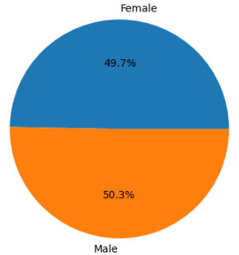

Gender
Data shows that air travel is equally popular among men and women.

Slide 6
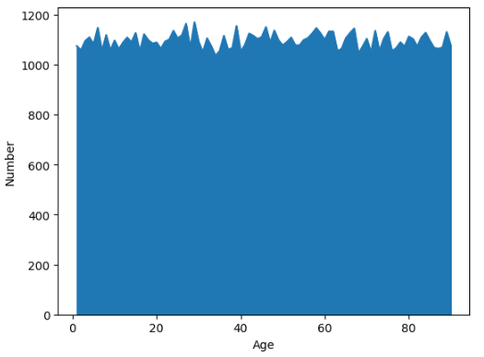
Age
According to the data provided, no relationship between the number of passengers and their age has been identified.
The minimum age of a passenger is 1 year, the maximum age is 90 years, the average age is 46 years.

Slide 7
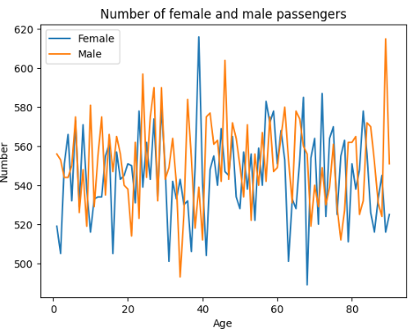
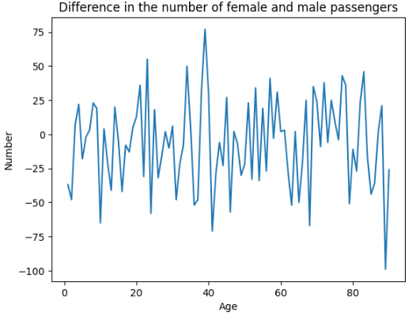
Age based on gender
Although we can see in the graphs fluctuations in the difference in the number of female and male passengers, there is no clear dependence of the number of passengers depending on gender and age.

Slide 8
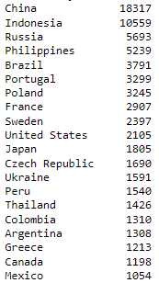
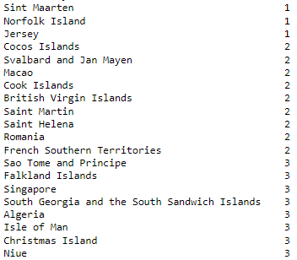
Nationality
20 maximum
20 minimum
The airline passengers included people of 240 nationalities.
The most numerous passengers were the following nationalities:
China, Indonesia, Russia, Philippines, Brazil, Portugal, France, Sweden, United States and Japan.

Slide 9
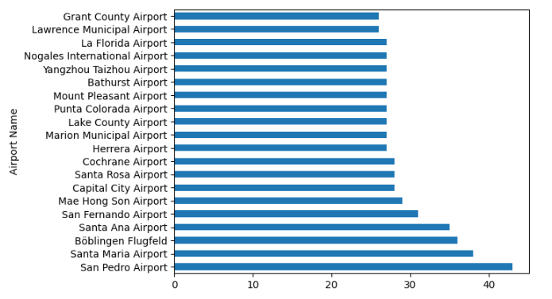
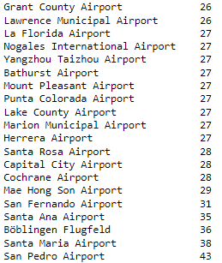

Airports
The database contains data from 9062 airports. The graph shows airports with maximum passenger traffic.

Slide 10
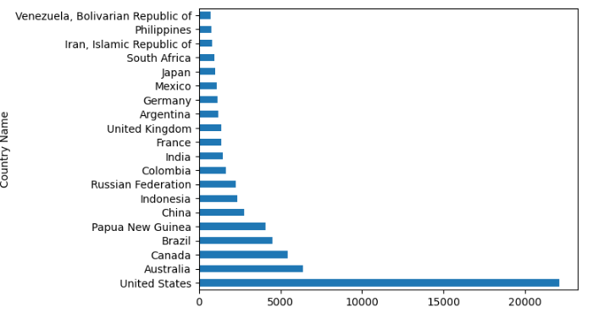
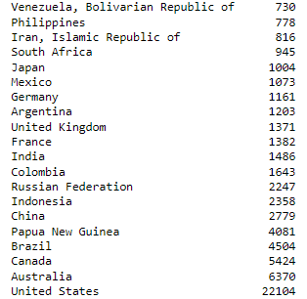
Countries
The database contains data from 235 countries. The graph shows the countries with the maximum passenger traffic.

Slide 11
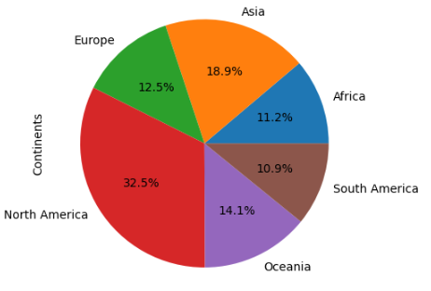

Continents
According to an analysis of data by continent, the highest passenger traffic is in North America, the lowest in South America.

Slide 12
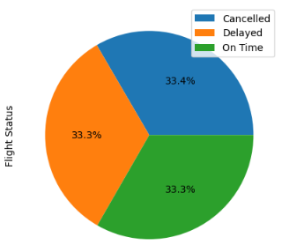

Flight Status
33.4% of flights were cancelled, 33.3% of flights were delayed and 33.3% of flights departed on schedule.

Slide 13
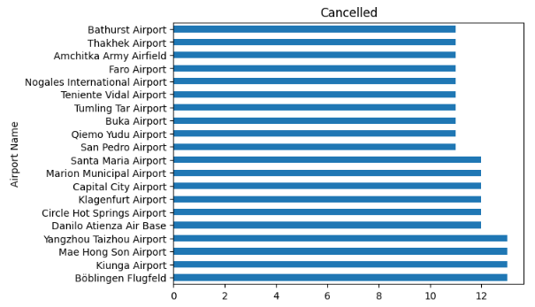
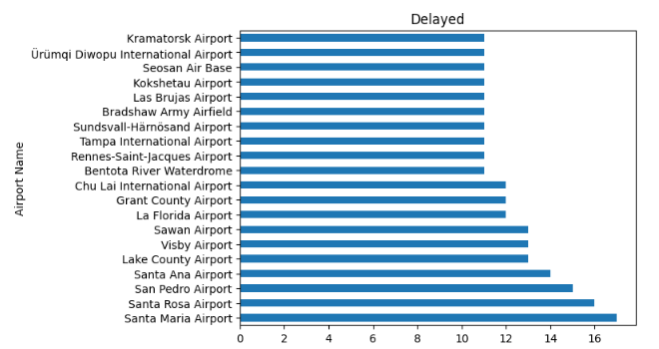
Flight status based on airport
The graphs show airports with the highest number of canceled and delayed flights.

Slide 14
Conclusions

Slide 15
As a result of data analysis, it was revealed that men and women are airline customers with the same frequency and there is no dependence of the number of passengers on age. The age of passengers ranges from 1 to 90 years.
Airline passengers include people of 240 nationalities, the most numerous passengers being people of the following nationalities: China, Indonesia, Russia, Philippines, Brazil, Portugal, France, Sweden, United States and Japan.
The database includes information on 9,062 airports in 235 countries operating on 5 continents. Countries with the highest passenger traffic are United States, Australia, Canada, Brazil, Papua New Guinea. North America is the continent with the highest passenger traffic.
A third of flights were cancelled, a third of flights were delayed and a third of flights departed on schedule.

